Slide 1
11-X
The signal System Call
Chapter 20,24,25,26

Slide 2
UNIX Process Control
Non-Existing
Process
↓ command
↑ Ctrl-c
↓ command &
↑ kill –2 pid
Running
Foreground
Process
Running
Background
Process
← fg
bg
↑ kill –2 pid
↓ Ctrl-z
↑ fg
↓ kill -20 pid
↑ bg
Stopped
Background
Process

Slide 3
sleep – system command
#include <unistd.h>
unsigned int sleep(unsigned int seconds);
Returns 0 on normal completion, or number of
unslept seconds if prematurely terminated
Definition - delay for a specified amount of time
Form - sleep NUMBER[SUFFIX]...
sleep OPTION
Description - Pause for NUMBER seconds.

Slide 4
UNIX Process Control
[Demo of UNIX process control using infloop.c]
/**********************************/
/* infloop.c */
/**********************************/
#include <stdio.h>
#include <stdlib.h>
int main(void)
/* print doing something, rest, and repeat again */
{
for (;;) {
printf("doing something ...\n") ;
sleep(2);
}
return EXIT_SUCCESS;
}
Notes:
csc60/ClassExamples/infloop

Slide 5
Running infloop
[bielr@athena ClassExamples]> infloop
doing something ...
doing something ...
doing something ...
doing something ...
doing something ...
^C
[bielr@athena ClassExamples]>

Slide 6
Signals (LPI page 388)
A signal is a notification to a process that an event has occurred.
Signals can come from another process or the kernel. A process can also send a signal to itself.

Slide 7
Signals from the Kernel
Types of events that cause the kernel to generate a signal:
Hardware exceptions
Problem with a machine instruction
Divide by zero
A reference to inaccessible memory
User-typed special characters
CTRL-C or CTRL-Z
Software event
Timer went off
Child of this process terminated
Terminal window was resized

Slide 8
Signals
Standard signals in Linux have:
names. Ex. SIGINT
numbers. Ex. SIGINT has the number 2
Linux has 31 standard signals
Standard signals are sometimes called Traditional signals
Realtime signals (LPI section 22.8)
Extension set to Standard signals
Allow signals to be queued
Allow data to accompany the signal

Slide 9
Signal Types (31 in POSIX) Table 20-1
Name | Description | Default Action
SIGINT ^C 2 | Interrupt character typed | terminate process
SIGQUIT ^\ 3 | Quit character typed | create core image
SIGKILL 9 | Sure kill | terminate process
SIGSEGV 11 | Invalid memory reference | create core image
SIGPIPE 13 | Write on pipe but no reader | terminate process
SIGALRM alarm() 14 | clock ‘rings’ | terminate process
SIGUSR1 10 | user-defined signal type | terminate process
SIGUSR2 12 | user-defined signal type | terminate process
SIGCHLD 17 | user-defined signal type | ignore
See man 7 signal

Slide 10

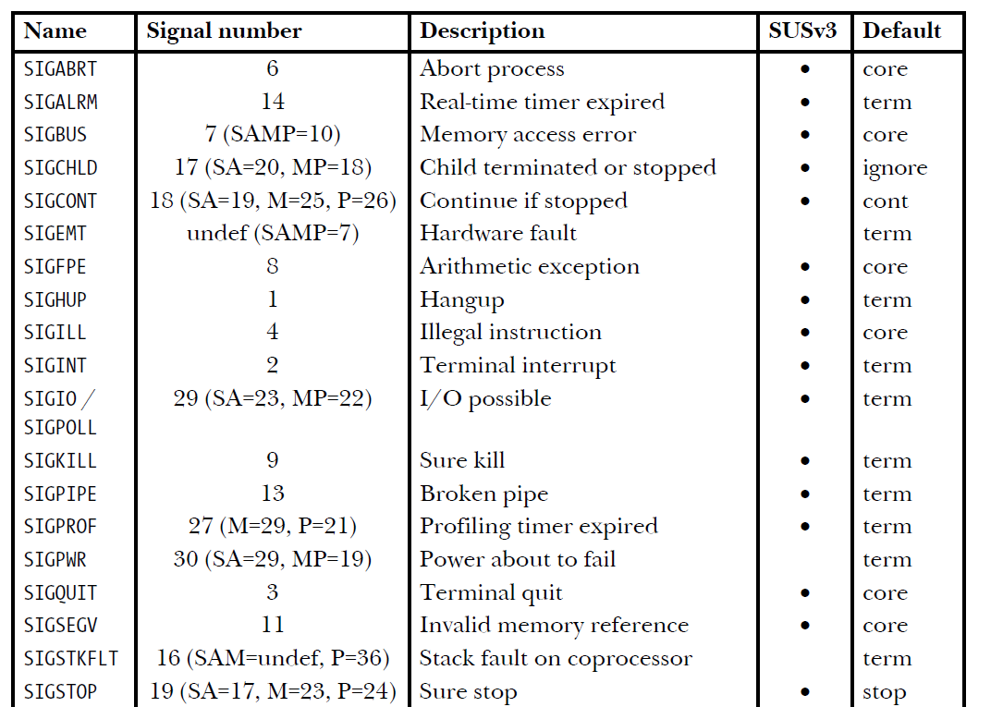

Slide 11
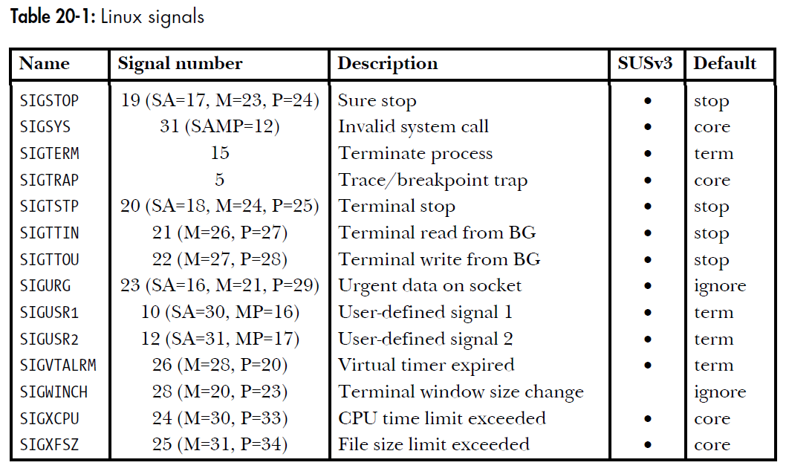

Slide 12
Process Control Implementation (1 of 2)
Exactly what happens when you:
Type Ctrl-c?
Keyboard sends hardware interrupt
Hardware interrupt is handled by OS
OS sends a 2/SIGINT signal, (Terminal interrupt)
Type Ctrl-z?
Keyboard sends hardware interrupt
Hardware interrupt is handled by OS
OS sends a 20/SIGTSTP signal, (Terminal stop)

Slide 13
Process Control Implementation (2 of 2)
Exactly what happens when you:
Issue a “kill –sig pid” command?
OS sends a sig signal to the process whose id is pid
Issue a “fg” or “bg” command?
OS sends a 18/SIGCONT signal, (Continue if stopped)
fg – foreground process, a shell command
bg – background process, a shell command

Slide 14
Vocabulary
Asynchronous – When discussing a Signal, it means it gets there when it gets there!
Sort of like the US Mail.

Slide 15
Definition of Signal
Signal: A signal is an asynchronous event which is delivered to a process.
Event gains attention of the OS
OS stops the application process immediately, sending it a signal
Signal handler executes to completion
Application process resumes where it left off
Process
movl
pushl
call f
addl
movl
.
.
.
void signal_handler(int iSig)
{
…
}
e.g. user types
ctrl-C
at anytime.
signal

Slide 16

Examples of Signals (1 of 2)
User types Ctrl-c
Event gains attention of OS
OS stops the application process immediately, sending it a 2/SIGINT signal
Signal handler for 2/SIGINT signal executes to completion
Default signal handler for 2/SIGINT signal exits process

Slide 17
Examples of Signals (2 of 2)
Process makes illegal memory reference
Event gains attention of OS
OS stops application process immediately, sending it a 11/SIGSEGV signal
Signal handler for 11/SIGSEGV signal executes to completion
Default signal handler for 11/SIGSEGV signal prints “segmentation fault” and exits process
PS: Since ptr is uninitialized, we would get a SEG_FAULT
If we said “ptr = 20”, it would not get fault until you tried
to access *ptr
int *ptr;
*ptr = 20;

Slide 18
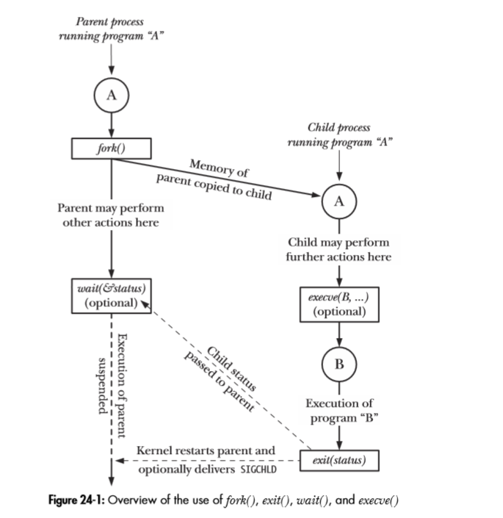
Example of Signal: fork, exit, wait, & execve

Slide 19
Sending Signals via Keystrokes
Three signals can be sent from keyboard:
Ctrl-c → 2/SIGINT signal
Default handler exits process
Ctrl-z → 20/SIGTSTP signal
Default handler suspends process
Ctrl-\ → 3/SIGQUIT signal
Default handler exits process

Slide 20
kill – system call
One process can send a signal to another process
using the kill() system call, which is the analog of the kill shell command.
(The term kill was chosen because the default action of most of the signals that were available on early UNIX implementations was to terminate the process.)
Today we use kill to send any signal, not just one to kill a process.

Slide 21
Sending Signals via Function Call
#include <signal.h>
int kill(pid_t iPid, int iSig);
Returns 0 on success, or –1 on error
Sends a iSig signal to the process whose id is iPid
Equivalent to raise(iSig) when iPid is the id of current process
Example:
pid_t iPid = getpid(); // Process gets its id.
kill(iPid, SIGINT); // Process sends itself
// a SIGINT signal

Slide 22
Other Examples
Can specify either signal type name (-SIGINT) or number (-2)
No signal type name or number specified => sends 15/SIGTERM signal
Default 15/SIGTERM handler exits process
Examples:
kill –2 1234
kill -SIGINT 1234
Same as pressing Ctrl-c if process 1234 is running in foreground

Slide 23
signal system call - Change signal disposition
#include <signal.h>
void ( *signal (int sig, void (*handler)(int)) ) (int);
Returns previous signal disposition on success,
or SIG_ERR on error
sig – the signal whose disposition we wish to change
handler – the address of the function that should be called when this signal is delivered
Form:
void handler (int sig)
{
/* code for the handler */
}

Slide 24
Sending Signals via Function Call
raise()
int raise(int iSig);
Commands OS to send a signal of type iSig to current process, itself.
Returns 0 to indicate success, non-0 to indicate failure
Example
int ret = raise(SIGINT);
/* Process commits termination. */
/* where SIGINT is the number */
/* of the signal to send */

Slide 25
Definitions for next picture
The SIGWINCH signal is sent to a process when its controlling terminal changes its size (a window change).
The SIGHUP signal is sent to a process when its controlling terminal is closed.
The SIGINT signal is sent to a process by its controlling terminal when a user wishes to interrupt the process. This is typically initiated by pressing Control-C.
The SIGKILL signal can be sent to a process to cause it to terminate immediately (kill).

Slide 26
Definitions for next picture
The SIGQUIT signal is sent to a process by its controlling terminal when the user requests that the process quit and perform a core dump. (Ctrl-\)
The SIGPIPE signal is sent to a process when it attempts to write to a pipe without a process connected to the other end.
SIGALRM is sent when real or clock time elapses.
The SIGUSR1 and SIGUSR2 signals are sent to a process to indicate user-defined conditions.

Slide 27
Signal Sources
terminal driver
memory management
shell command
SIGINT
SIGHUP
SIGQUIT
SIGKILL
kernel
SIGPIPE
a process
SIGWINCH
SIGALRM
window manager
SIGUSR1
other user processes

Slide 28
Responding to a Signal
A process can:
ignore/discard the signal
not possible with SIGKILL or SIGSTOP
execute a signal handler function, and then possibly resume execution or terminate
carry out the default action for that signal
The choice is called the process’s signal disposition

Slide 29
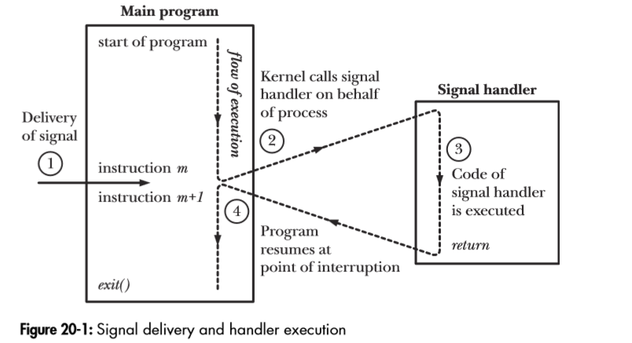
Signal delivery & handler execution (LPI Page 399)

Slide 30
Example: ouch.c (LPI page 399)
#include <signal.h>
#include <stdio.h>
#include <stdlib.h>
static void sigHandler(int sig) {
printf("Ouch!\n"); /* UNSAFE (see Section 21.1.2) */
}
int main(int argc, char *argv[]) {
int j;
if (signal(SIGINT, sigHandler) == SIG_ERR)
fprintf(stderr, "signal");
for (j = 0; ; j++) {
printf("%d\n", j);
sleep(3); /* Loop slowly... */
}
return EXIT_SUCCESS:
}
Notes:
csc60/ClassExamples/ouch

Slide 31
Running the ouch program
[bielr@athena ClassExamples]> ouch
0
1
^C Ouch!
2
3
^C Ouch!
4
5
6
^C Ouch!
7
8
^\Quit (core dumped)
[bielr@athena ClassExamples]>

Slide 32
Chapter 21. Signals: Signal Handlers

Slide 33
Async-Signal-Safe Function (1 of 2)
An Async-Signal-Safe function is one in which the implementation guarantees to be safe when calling from the signal handler.
A function is Async-Signal-Safe because it is not interruptible by a signal handler.
Note: /* UNSAFE (see Section 21.1.2)
Page 422 */

Slide 34
Async-Signal-Safe Function (2 of 2)
For example:
Suppose a program is in the middle of a call to printf(3) and a signal occurs whose handler itself calls printf().
In this case, the output of the two printf() statements would be intertwined. To avoid this, the handler should not call printf() itself when printf() might be interrupted by a signal.
Question: Then, what function(s) would we use instead?

Slide 35
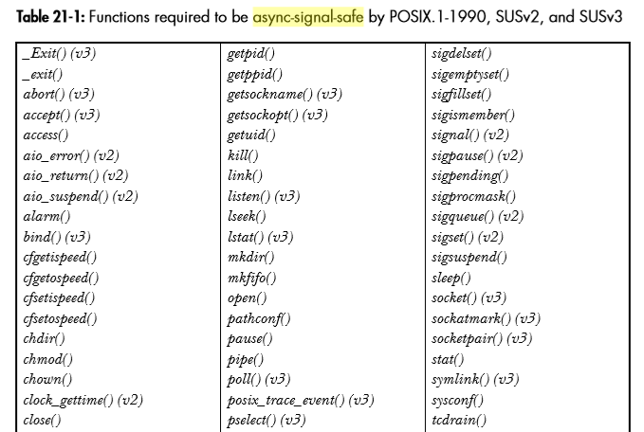
Async Signal Safe Functions (Table 21-1/Page 426, UPPER half of table)

Slide 36
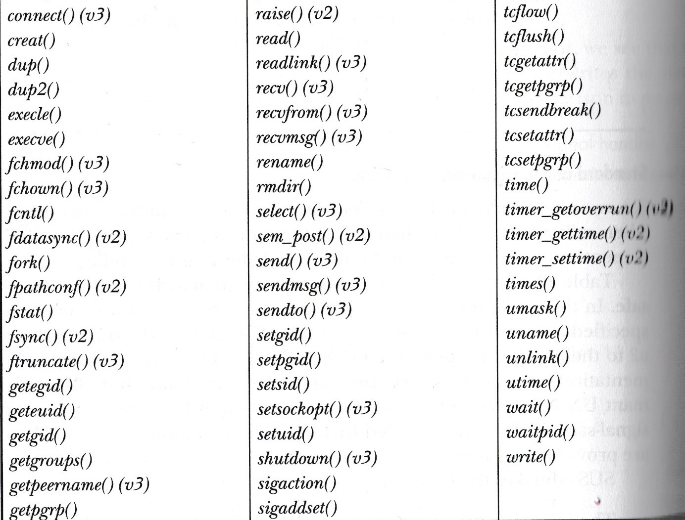
Async Signal Safe Functions (Table 21-1/Page 426, Lower half of table)

Slide 37
Special Sigfunc* Values used in signal() function
Value Meaning SIG_IGN Ignore / discard the signal.
Example: To ignore a ctrl-c command from the command line.
SIG_DFL Use default action to handle signal.
Example: To reset system so that SIGINT causes a termination at any place in our program.
SIG_ERR Returned by signal() as an error.

Slide 38
Handling Multiple Signals
If many signals of the same type are waiting to be handled (e.g. two SIGINTs), then most UNIXs will only deliver one of them. (Signals are not queued). The others are thrown away.
If many signals of different types are waiting to be handled (e.g. a SIGINT, SIGSEGV, SIGUSR1), they are not delivered in any fixed order.

Slide 39
pause()
Suspend the calling process until a signal is caught.
#include <errno.h> #include <unistd.h> int pause(void);
Returns -1 with errno assigned EINTR. (Linux assigns it ERESTARTNOHAND).
pause() only returns after a signal handler has finished.

Slide 40
pause() Example (1 of 3)
#include <stdio.h>
#include <unistd.h>
#include <signal.h>
void sig_usr( int signo ); /* handles two signals */
int main() {
int i = 0;
if( signal( SIGUSR1,sig_usr ) == SIG_ERR )
printf( "Cannot catch SIGUSR1\n" );
if( signal( SIGUSR2,sig_usr ) == SIG_ERR )
printf("Cannot catch SIGUSR2\n");
while(1) {
printf("%2d\n", i );
pause();
/* pause until signal handler has processed signal */
i++;
} /* end of while loop */
return 0;
} /* end of main */
Notes:
csc60/ClassExamples/pause

Slide 41
pause() – Example (2 of 3)
/* argument is signal number */
void sig_usr( int signo )
{
if( signo == SIGUSR1 )
printf("Received SIGUSR1\n");
else if( signo == SIGUSR2 )
printf("Received SIGUSR2\n");
return;
}
Note: Executing a program with an “&” puts the program in the background.
Notes:
Next slide. The "&" puts pause in the background.

Slide 42
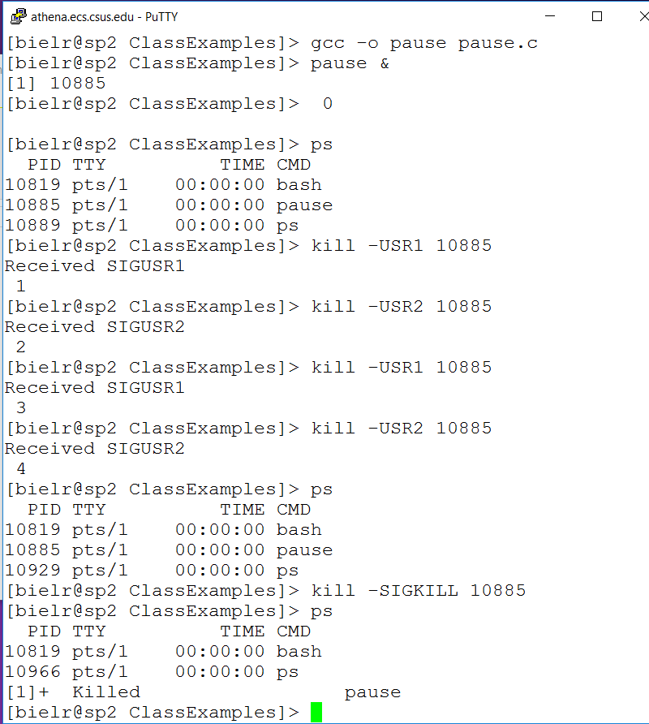
pause() – Example (3 of 3)

Slide 43
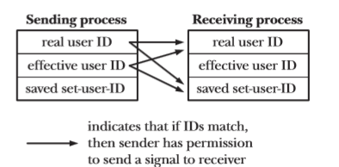
kill and raise - System Calls
int kill(pid_t pid, int sig);
int raise(int sig);
kill sends a signal to a process or group of processes
pid > 0 – send to process with PID = pid
pid = 0 – send to all processes with PGID = PGID of caller
pid < 0 – send to all processes with PGID = |pid| (to a group)
pid = -1 – send to all processes to which it has permission to send a signal
To send signals to other processes,
Real user ID/EUID (Effective User Id)
must match
raise allows a process to
send a signal to itself

Slide 44
Signal Sets
Multiple signals are represented using a data structure called a signal set, provided by the system data type sigset_t.
The signal set stores collections of signal types.
Sets are used by signal functions to define which signal types are to be processed.
POSIX contains several functions for creating, changing, and examining signal sets.

Slide 45
Prototypes
#include <signal.h>
/* Initialize signal set to contain no member */ int sigemptyset( sigset_t *set );
/* Initialize signal set to contain all signals */ int sigfillset( sigset_t *set );
/* Add individual signal */ int sigaddset( sigset_t *set, int signo );
/* Remove individual signal */
int sigdelset( sigset_t *set, int signo );
/* Check to see if a signal is a member of a set */ int sigismember( const sigset_t *set, int signo );

Slide 46
The Signal Mask
For each process, the kernel maintains a signal mask – a set of signals whose delivery to the process is currently blocked.
If a signal that is blocked is sent to a process,
delivery of that signal is delayed
until it is unblocked by being removed from the process signal mask

Slide 47
sigprocmask()
A process uses a signal set to create a mask which defines the signals it is blocking from delivery. – good for critical sections where you want to block certain signals.
#include <signal.h>
int sigprocmask( int how, const sigset_t *set, sigset_t *oldset);
/* how – indicates how mask is modified */
Note: SIGKILL and SIGSTOP cannot be blocked by sigprocmask.

Slide 48
“how” Meanings
Value | Meaning
SIG_BLOCK | set signals are added to mask
SIG_UNBLOCK | set signals are removed from mask
SIG_SETMASK | set becomes new mask

Slide 49
Example of a CRITICAL CODE REGION
sigset_t newmask, oldmask; sigemptyset( &newmask ); sigaddset( &newmask, SIGINT ); /* block SIGINT; save old mask */ sigprocmask(SIG_BLOCK, &newmask, &oldmask ); /* critical region of code */
/* where a signal would interfere */
/* with task */ /* reset mask which unblocks SIGINT */ sigprocmask( SIG_SETMASK, &oldmask, NULL );
Notes:
Look at code from Spring 2016

Slide 50
Signal - Review
A signal is a notification that some kind of event has occurred.
Send to a process by kernel, another process, or by itself.
Different kind of signals. Each has unique id and purpose.
Signal is typically asynchronous (unpredictable).
Signal can be ignored, terminate a process, stop a process, or restart of stopped process. Also, see table 20-1.
Signal can be also be ignored and/or handled by a programmer’s handler (catcher) function.
Later: Recommend to use sigaction() – more flexible/portable

Slide 51
sigaction() system call
A newer alternative to signal()
Used to change the action taken by a process on receipt of a specific signal.
More complex than signal() but offers greater flexibility
(See signal(7) for an overview of signals.)

Slide 52
sigaction() System Call
#include <signal.h> int sigaction(int signo, const struct sigaction *act, struct sigaction *oldact );
The arguments are explained on the next slide.
Note: why there is no const in front of struct sigaction *oldact ?
Because the call is going to modify it, so no constant!

Slide 53
sigaction() arguments
sig – identifies the signal whose disposition we want to retrieve or change.
act – pointer to a structure specifying a new disposition for the signal
oact – pointer to a structure of the same type & is used to return information about the signal’s previous disposition

Slide 54
sigaction Structure
struct sigaction
{ void (*sa_handler)( int ); / * address of handler */
sigset_t sa_mask; /* signal blocked during invocation */
int sa_flags; /* flags control invocation */
/* (see page 417) */
void (*sa_sigaction)( int, siginfo_t *, void * );
/* not for application use */
}
sa_flags – (typically has a 0 value)
SIG_DFL reset handler to default upon return
SA_SIGINFO denotes extra information is passed to handler
(.i.e. specifies the use of the “second” handler in the structure.

Slide 55
sigaction() Behavior
A signo signal causes the sa_handler signal handler to be called.
While sa_handler executes, the signals in sa_mask are blocked.
sa_handler remains installed until it is changed by another sigaction() call.
Notes:
Next slide has multiple drop-downs.

Slide 56
Signal Raising
struct sigaction
{
void (*) (int) sa_handler
sigset_t sa_mask
int sa_flags
}
int main() {
struct sigaction act;
act.sa_handler = ouch;
sigemptyset( &act.sa_mask );
act.sa_flags = 0;
sigaction( SIGINT, &act, 0 );
while(1) {
printf("Hello World!\n");
sleep(1);
}
}
Set the signal handler to
be the function ouch
We can manipulate
sets of signals..
No flags are needed here.
Possible flags include:
SA_NOCLDSTOP
SA_RESETHAND
SA_RESTART
SA_NODEFER
This call sets the signal
handler for the SIGINT
(ctrl-C) signal

Slide 57
#include <signal.h> //the code (that works on athena) #include <stdlib.h> #include <stdio.h> static void ouch(int sig) { printf("Ouch!\n"); /* UNSAFE (see Section 21.1.2) */ } int main(void) { struct sigaction act; act.sa_handler = ouch; sigemptyset( &act.sa_mask ); act.sa_flags = 0; sigaction( SIGINT, &act, 0 ); while(1) { printf("Hello World!\n"); sleep(1); } }
Notes:
csc60/ClassExamples/sigaction

Slide 58
Signals - Ignoring signals
Other than SIGKILL and SIGSTOP, signals can be ignored:
Instead of in the previous program:
act.sa_handler = ouch; /* or whatever */
We can use:
act.sa_handler = SIG_IGN;
The ^C key will be ignored

Slide 59
Restoring previous action
The third parameter to sigaction, oact, can be used:
/* save old action */
sigaction( SIGTERM, NULL, &oact );
/* set new action */
act.sa_handler = SIG_IGN;
sigaction( SIGTERM, &act, NULL );
/* restore old action */
sigaction( SIGTERM, &oact, NULL );

Slide 60
11-UNIX
The signal System Call
The End

